Slide 1


@alicerugglestrust
www.alicerugglestrust.org
Recognising and Responding to Stalking
Notes:
The Alice Ruggles Trust was set up in 2018 to raise awareness of stalking and coercive control.
We aim to prevent what happened to Alice happening to others.
The song you hear playing is not a love song, but a song about stalking and obsession, and this can be very dangerous as it was for Alice who was stalked and then murdered by an ex-partner. This film was made by her family about what happened:

Slide 2
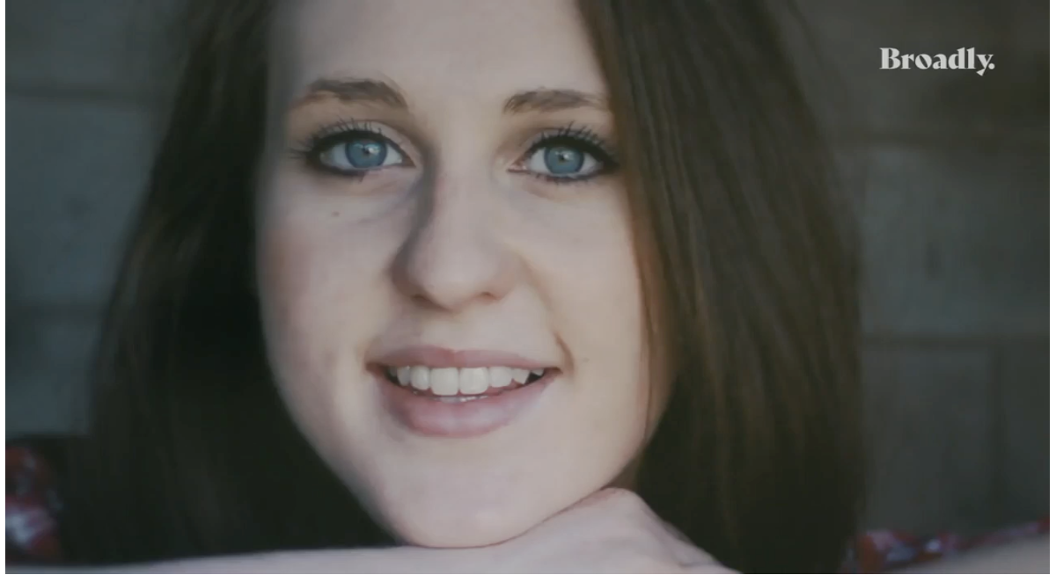

Alice’s story
@alicerugglestrust
www.alicerugglestrust.org
Trigger warnings: violence, domestic abuse, stalking.
Notes:
https://video.vice.com/en_us/video/unfollow-me-the-story-of-alice-ruggles/5b51cb13be407706403b2498 (5 minutes 48 seconds) (subtitles available) (image is hyperlinked)
This video tells Alice’s story, and it can be tough to watch.
Please do what you need to take care of yourself, even if that means leaving the room or taking a break. If you need support, we encourage you to seek help your teacher. Unhealthy relationships are an issue amongst all types of relationships, no matter gender, sexuality, class, ability, religion, or race.
Alice was kind, clever and beautiful. She loved life, loved her friends and loved her job. She had so much to live for. Tragically, Alice was murdered in Gateshead on 12 October 2016, aged just 24.
Alice’s ex-partner was convicted of her murder and sentenced to life imprisonment with a minimum tariff of 22 years. His controlling behaviour during their brief relationship had developed afterwards into a relentless campaign of stalking.
The police are much better at dealing with this now, but Alice would have sought help sooner if she had understood the danger she was in, and it is important that it is taken seriously before things escalate out of control.
The message that we are trying to spread is to take it seriously and take action quickly. If Alice had done this sooner, then she might be Alive today.
(An alternative video can be viewed: please see facilitator pack, or online https://www.alicerugglestrust.org/stalking-video)
If using the alternative video: This video explains how to spot the risks of stalking, and what to do.

Slide 3
@alicerugglestrust
What is stalking?
www.alicerugglestrust.org
  Stalking is “a pattern of unwanted, fixated and obsessive behaviour which is intrusive and causes fear of violence or serious alarm or distress”
Notes:
No legal definition of stalking but this is the professionally recognised definition:​ “A pattern of unwanted, fixated and obsessive behaviour which is intrusive and causes fear of violence or serious alarm or distress”
What does this mean?​
​
Pattern: something that happens over and over again. Might not be the same behaviour but the behaviours are done for the same reason, to get your attention. Research says that stalking victims experience 100 incidents before speaking up. We want to support people to come forward much sooner.
​
Unwanted​: You have said ‘no’ you do not want this person to be in your life in the way that they want. This can be complicated if you’re in the same friendship group or classes but your ‘no’ needs to be respected
Fixated behaviour​: Being only interested in one person or one thing. You think about them all the time, what are they up to, what are they having for breakfast, would they like this song?
Has an impact on the victim​: How does all this make you feel?
Has been illegal since 2012 – Just recognised 10 years of the legislation.
Stalking is a crime.
Perpetrators can face to up to 10 years in prison, or 14 years if the crime is racially or religiously motivated.
A lot of progress has been made since Alice was murdered thanks to campaigners and police forces.

Slide 4
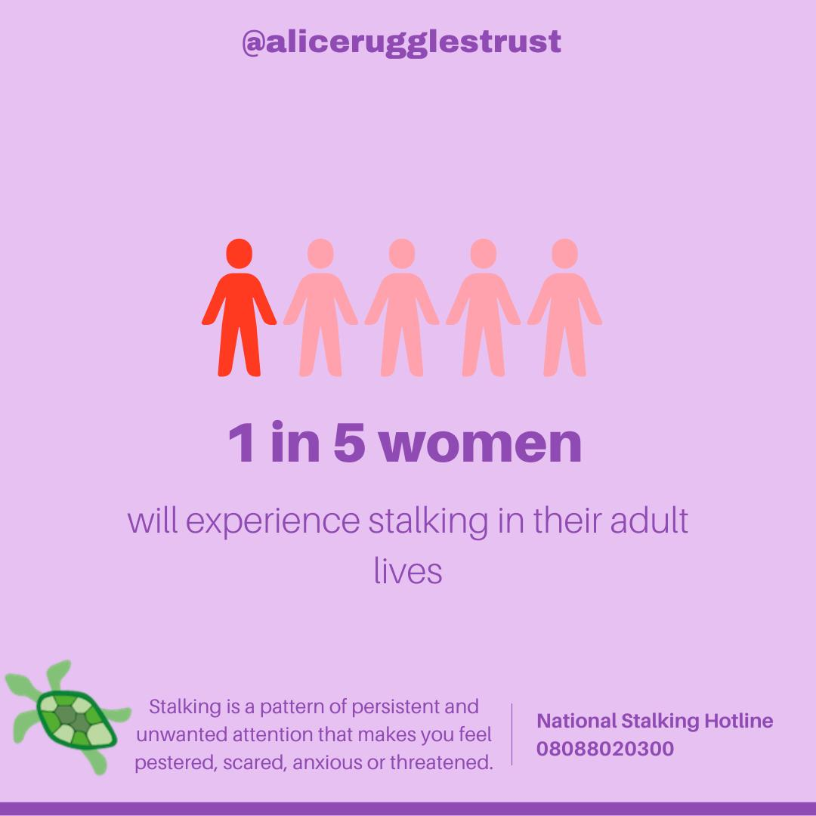
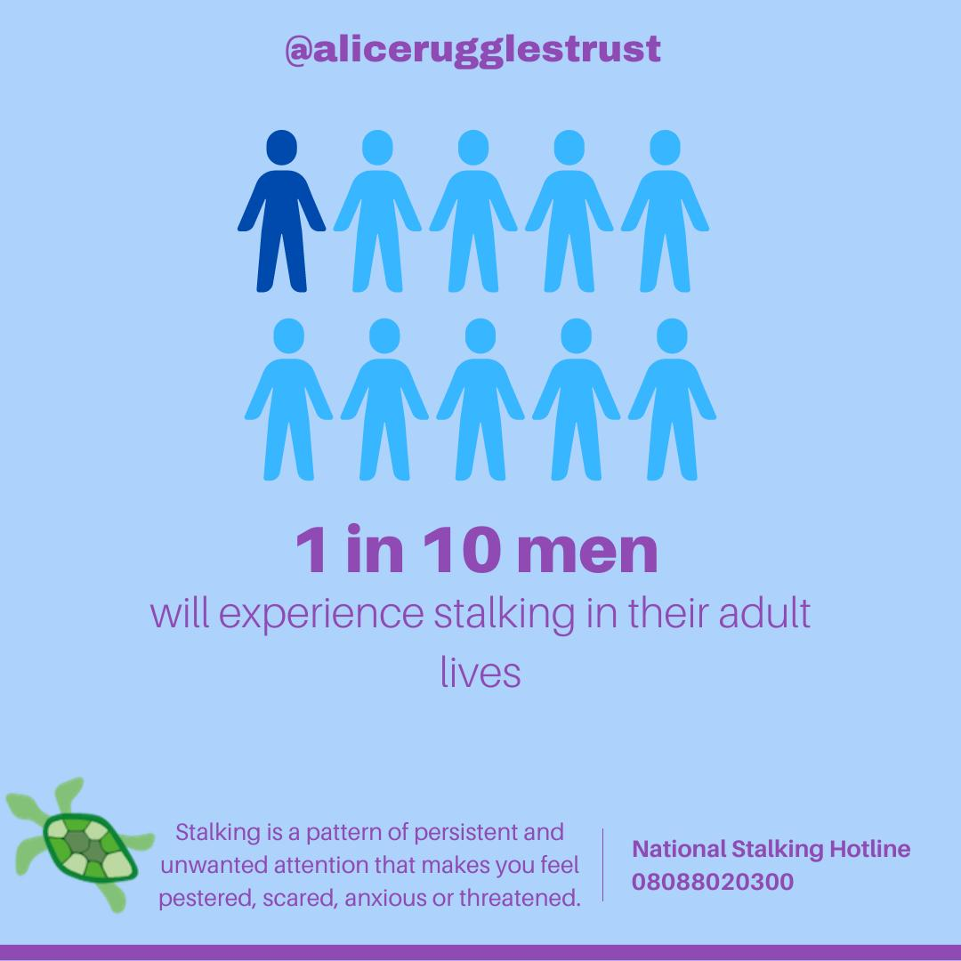
What is stalking?
@alicerugglestrust
www.alicerugglestrust.org
Notes:
Stalking affects 1 in 5 women and 1 in 10 men
523,000 young people aged 16-24 experience stalking each year
Stalking does not just happen to one person, it affects up to 21 people around the primary victim either as the stalker tries to get people to speak on their behalf, or add to the negative behaviours.
People often associate stalking with being followed by a stranger, but most is perpetrated by someone the victim knows.

Slide 5
Motivations
@alicerugglestrust
www.alicerugglestrust.org
Rejection
Loneliness
Sometimes unhealthy behaviours can continue after a relationship (romantic or not) breaks down. This can be very difficult to navigate and, in some cases, can be very distressing. If you are experiencing unwanted behaviours, it’s important to not ignore them and understand they can escalate. Trust your gut and get help.
Violence
Violence
Resentment
Romantically or socially awkward
Notes:
Why do people stalk? What leads them to?
It’s ok to feel hurt or upset about the breakdown of a relationship, but if you are becoming obsessed, you need to seek help.
There are many motivations for stalking…
Rejection
Being dropped by someone can be hard for anyone. Most of us get angry, get sad and move on. Some people don't though and can end up spending a lot of time either trying to make up or punish the other person.
Loneliness
Some people can believe there is a connection or relationship between themselves and another person even when one does not exist. The need for a relationship can lead to intrusive behaviours that can be unsettling or scary.
Resentment
Feeling mistreated can lead people to need revenge and to get back at a person, often in unpleasant ways.
Romantically or socially awkward
When loneliness and poor social skills are mixed together a person may genuinely not understand a 'no' and be indifferent to the distress they are causing by pursuing a dead-end.
Violence
The rarest behaviour is motivated by violence alone. There is no other reason for the fixated behaviour than to get kicks from causing pain.

Slide 6
Some stalking behaviours
@alicerugglestrust
www.alicerugglestrust.org
Hang around outside or enter your home or workplace
Follow you or track your movements
Show up wherever you go
Send unwanted gifts
Threaten to share risky photos
Send unwanted letters, messages, texts and emails
Spy on your phone
Hack your socials
Threaten you
Threaten suicide
Message your friends or family
Spread harmful rumours about you
Continue to contact you after you have told them not to
Constantly message you
Post untrue things about you
Set up fake accounts
Accuse you of stalking
Notes:
Motivations lead to stalking, which can cover a huge range of behaviours. These are just some of the behaviours which perpetrators may display. This list does not include everything.
Cyberstalking is on the rise. All cases of stalking now have an online element.
If you are making changes to your life in order to feel safe, then it is a sign that you are being stalked.

Slide 7
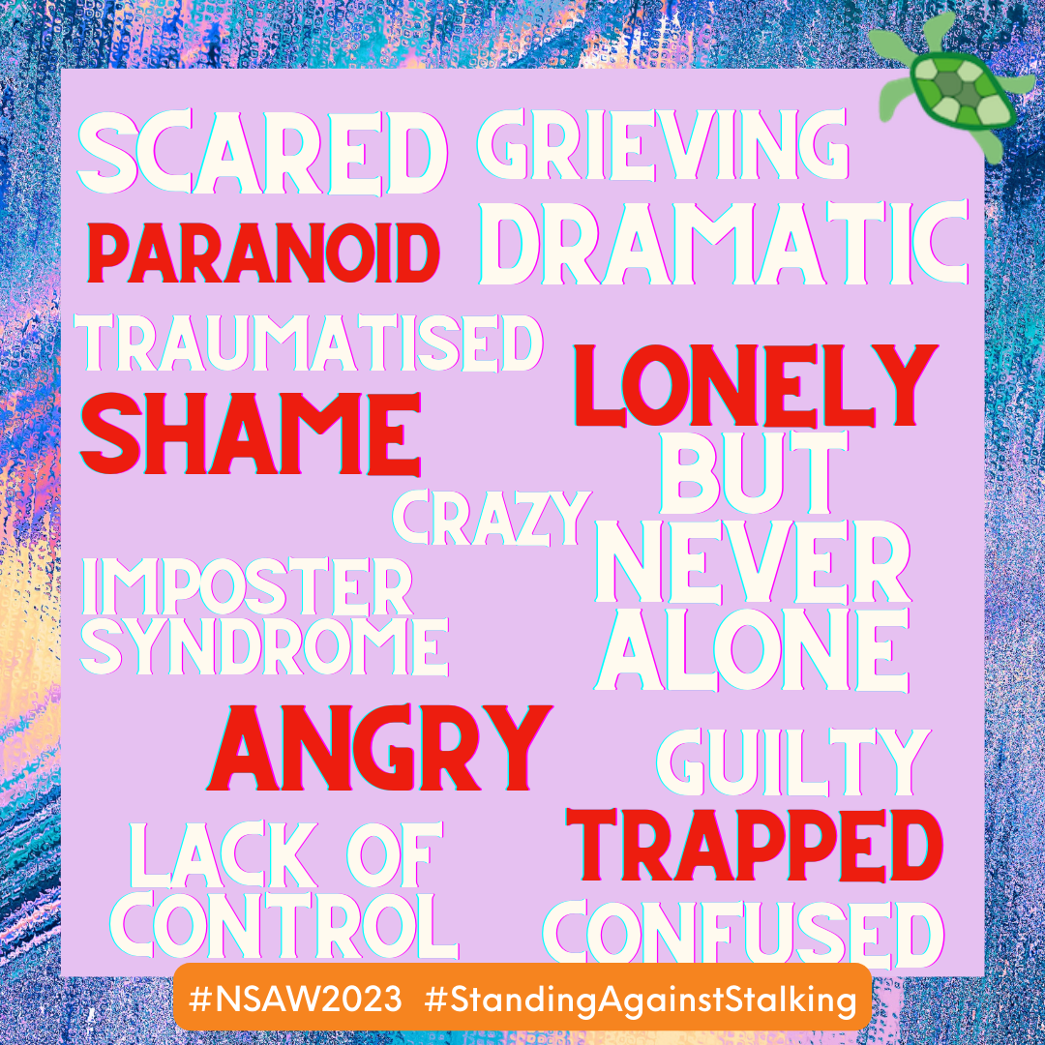
How does it feel to be stalked?
@alicerugglestrust
www.alicerugglestrust.org
"It was kind of like imposter syndrome... all these other people have got real problems, and my problem is someone loves me too much."
Notes:
These words were spoken by a victim of stalking.
Being stalked can be very very scary. 78% of victims experience symptoms of PTSD.
If you feel like you are at risk of perpetrating these behaviours, you need to seek help.

Slide 8



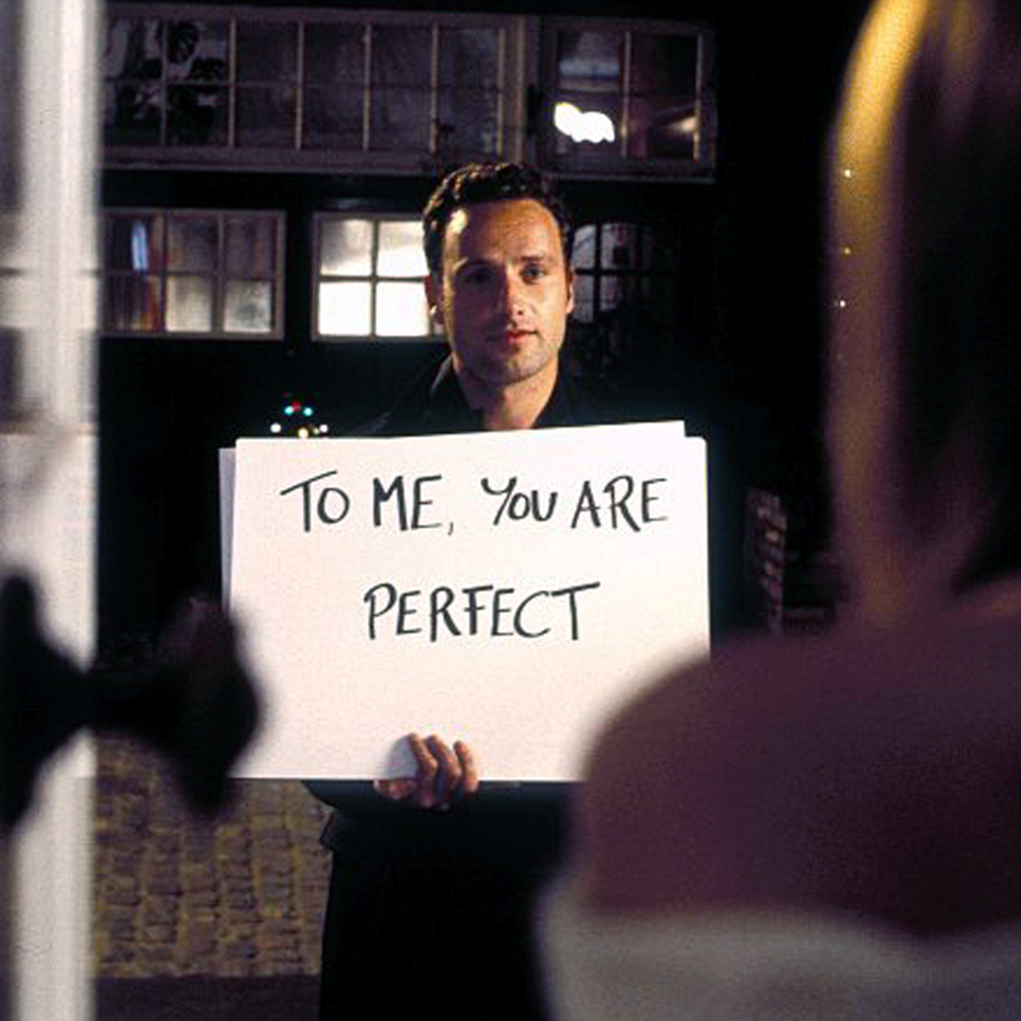
@alicerugglestrust
Stalking in popular culture
www.alicerugglestrust.org
Notes:
In popular culture stalking is often glamorised, and this reinforces and normalises unhealthy relationship behaviours which are not ok. ‘no doesn’t mean no’
Think about Netflix’s You, the Twilight Saga. Can you think of any other examples?
Stalking appears in songs too, think about the lyrics to ‘every step you take’ by The Police, or ‘one way or another’ by Blondie.

Slide 9

If you think you are being stalked
@alicerugglestrust
www.alicerugglestrust.org
Call the police
Seek support
Limit contact
Vary your routine
Talk about it
Record it
Be cyber secure:
  Change your passwords
  Check your privacy settings
  Scan for spyware
  Visit getsafeonline.org
Notes:
If you find that you are experiencing stalking or any other form of abuse, it is never your fault, but there are a lot of helpful things to know.
It is important to take uncomfortable behaviour seriously early on.
Call the police: Stalking is a crime. Those being stalked should call the police on 101 or 999 in an emergency and say they are being stalked.
Seek support: Stalking support services can help, including the National Stalking Helpline: www.stalkinghelpline.org.
Limit contact: As long as it feels safe to do so, keep contact with the stalker to an absolute minimum.
Vary your routine: and make sure a trusted person knows your location in case of emergency.
Talk about it: Tell as many trusted people as possible about what is happening and keep track of who has been told (e.g. GP, tutor etc),
Record all contact: Capture everything: screenshots, call logs, keep a diary: time, dates, locations of incidents, any witnesses and include how the behaviours felt at the time in any entries. This helps the police do their job to protect a target of stalking.
Be cyber secure: Change passwords, check privacy settings, scan for spyware, visit getsafeonline.org.

Slide 10
@alicerugglestrust
Remember:
www.alicerugglestrust.org
If someone won’t accept ‘ no ’ or if you say ‘ stop ’ and they do not listen:
It is not your fault
You did nothing wrong
You did not lead them on
You do not have to go along with them to stop them getting angry or make them leave you alone

Slide 11
@alicerugglestrust
Helping a friend
www.alicerugglestrust.org
Be patient, be calm, be safe
Listen and believe
Tell them it's not their fault
Don’t judge them
Remind them they are not alone; be there
If anyone is in immediate danger contact the police on 999 as soon as possible.
Notes:
It can be difficult to know what to do if a friend or loved one is in this situation. It is important that the situation is taken seriously so that the risk is minimised.
https://www.wefindaway.org.uk/how-can-i-help
Be patient
Usually it takes someone who experiences domestic abuse several years to seek help. Don't take it personally if they don’t immediately confide in you, make sure they know you are always there if they do need you.
Be calm
Even though it might be upsetting to hear that someone you care about is being treated that way and at risk of harm, try to stay calm. This will help the person you care about feel calmer too, and show them that they can talk to you openly without upsetting you.
Be safe
Finally, be safe - don’t put yourself or the person you're worried about at risk. Try and talk face-to-face and in private if you can. Remember that their social media, phone, and emails might be monitored. Never confront the abuser or act as a go-between.
Listen & believe
If someone tells you about abuse, or worrying behaviour they are experiencing, make sure you listen and validate their experience. Let them know that you believe them. Try not to make assumptions.
Tell them it’s not their fault
Many abusers will make the person they abuse blame themselves. Tell them that no one deserves to be treated that way, despite what their abuser has told them. Nothing they can do or say can justify the abuser’s behaviour. Reassure them that abuse can happen to anyone and the only person responsible is the abuser.
Don’t judge them
Don’t ask why they haven’t left or judge their choices. Instead, build their confidence and focus on their strengths. People in abusive relationships need support and understanding – not judgement. There are many reasons why it’s difficult for someone being abused to leave. Those reasons are all valid for them. Leaving is a process and they may make many attempts. Remember, the abuser alone is responsible for the abuse.
Remind them they’re not alone
Seeking help can feel lonely, and sometimes scary. The person you care about may have been deliberately isolated. Say you are there for them, and that there are solutions. Tell them that they are not alone and that there are many people in the same situation. Be ready to provide information on organisations that can offer support. Reassure them by letting them know that they are not alone, and that you will be there to help. Explore the available options with them. Find your local service at Who else can help?
Be there
The abuser will try to isolate them, making it harder to reach out to someone or ask for help. Even if they always say no, contact them to ask if they want to meet-up, invite them to social activities and ask how they are. Try and keep in touch with them, stay connected - it might seem like something small, but it can make a huge difference.

Slide 12
Sources of support
@alicerugglestrust
www.alicerugglestrust.org
At school - tutors, school nurse, counsellor
Police - 999 or 101
National Stalking Helpline – call 0808 802 0300, email, or visit www.stalkinghelpline.org
24-hour National Domestic Violence Freephone Helpline - 0808 2000 247
Respect - support those exhibiting controlling behaviours - 0808 802 4040
Men’s Advice Line - supports men with controlling partners - 0808 801 0327
The Mix - search crime and safety.
The CyberHelpline - support for victims of cyber-crime and online harms https://www.thecyberhelpline.com/gethelp
Findaway - Helping friends and family https://www.wefindaway.org.uk/how-can-i-help
Notes:
These resources will be sent to your school after this assembly.

